Slide 1


Countdown Timer: A Java OOP Implementation
Presentation by
Shawon Gazi
ID: 241400031
1

Slide 2
Table Of Content
Introduction
Project Objectives
Features of a Timer
Tools & Technologies
OOP Concepts Used
Code Snippet
Future Improvements
Q & A Session
2

Slide 3

What is a Countdown Timer?
A countdown timer is a tool that counts down from a set time (hours, minutes, seconds) to zero. It helps track remaining time and notifies when the time is up.
3

Slide 4




Why Countdown Timer?
It is widely used in alarms, quizzes, games, Cooking, and productivity apps.
4

Slide 5

Features of a Timer
User can input hours, minutes, and seconds.
Displays time remaining in hh:mm:ss format.
Counts down every second using Thread.sleep().
Shows “Time’s Up!” message when countdown ends.
5

Slide 6


Tools & Technologies
Language: Java (JDK 8+)
IDE: IntelliJ IDEA / Eclipse / VS Code / Netbins
Platform: Console-based (Terminal)
6

Slide 7

OOP Concepts Used
Abstraction
08
01
Class
Polymorphism
07
02
Constructor
Encapsulation
06
03
Method
05
04
Loop
Inheritance
7

Slide 8
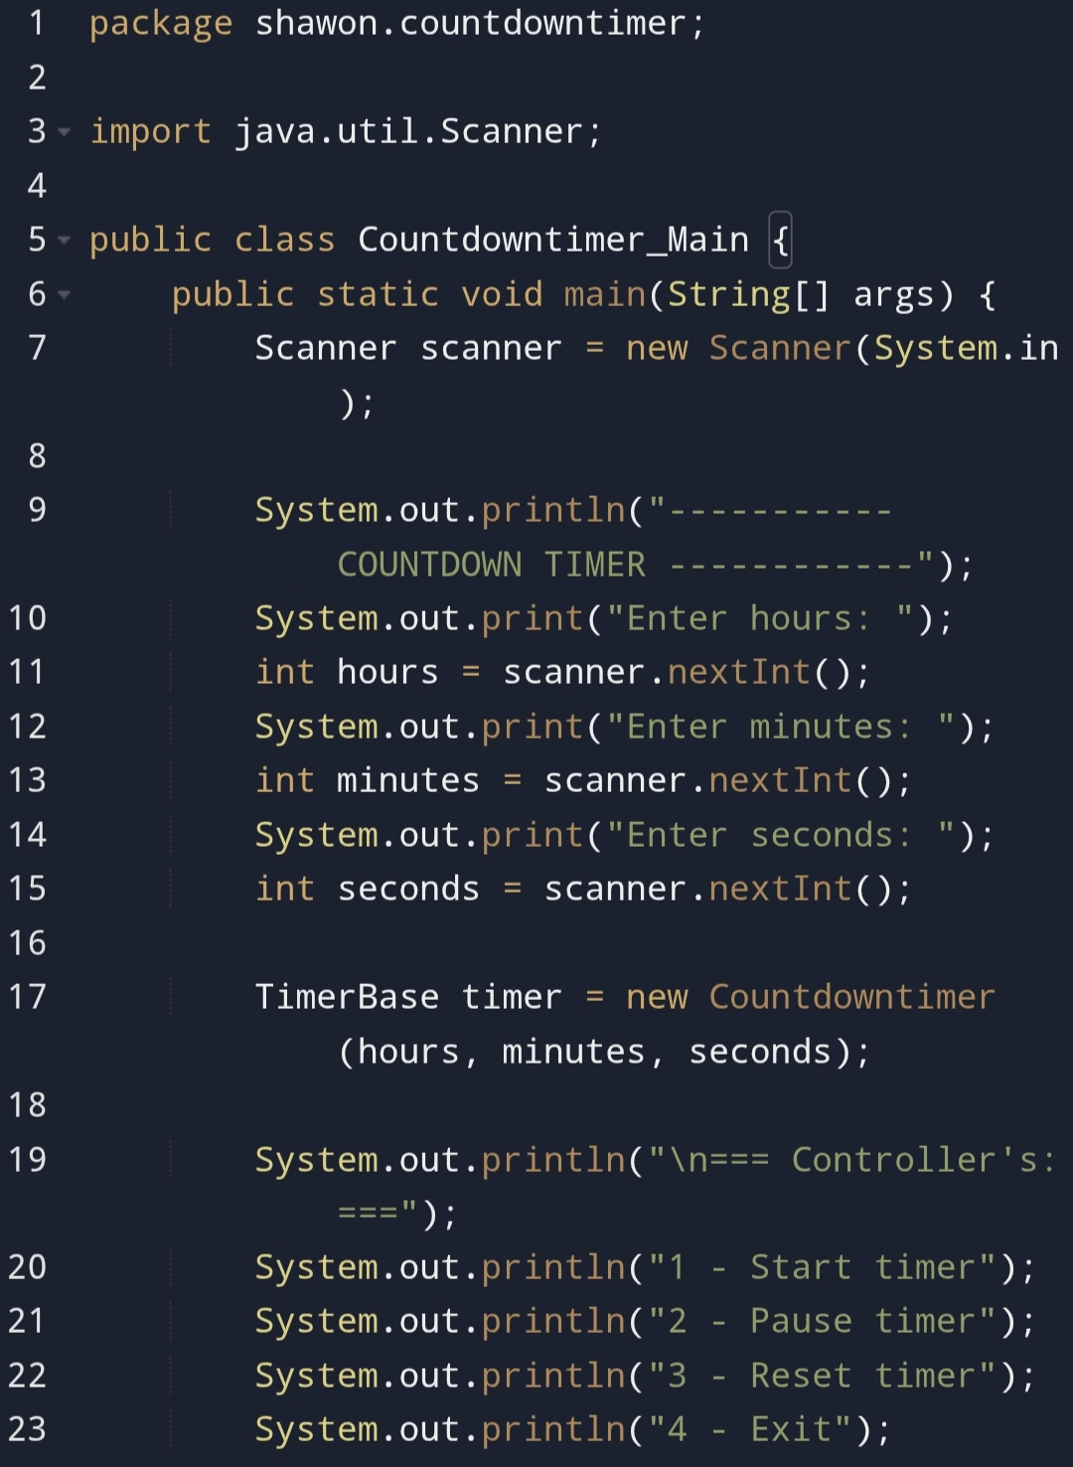
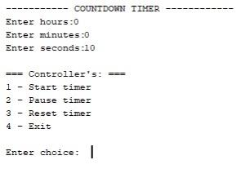
Code Snippet
8

Slide 9
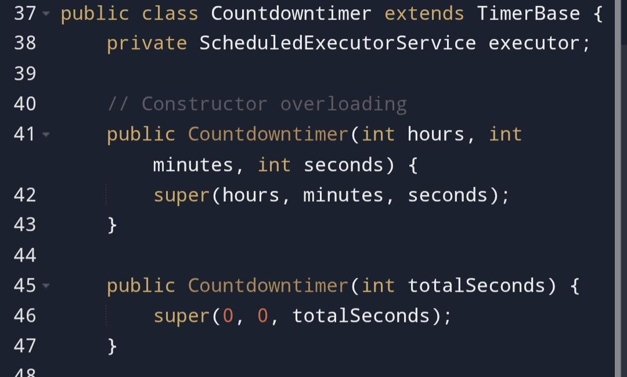
Code Snippet
9

Slide 10
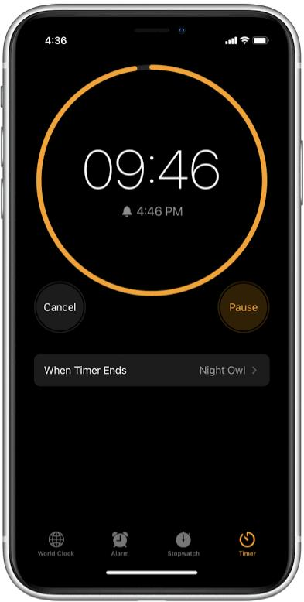
Future Improvements
Add sound notification or alert
GUI version using JavaFX or Swing
Save timer presets for repeated use
10

Slide 11



QUESTION SESSION
If you have any questions, feel free to ask now...
11

